Slide 1


Strengthening Resident and Family Councils
Maximizing Resident Engagement
Part II - Accommodations and Adaptation
Notes:
Welcome to this educational program, “ Maximizing Resident Engagement through Accommodations and Adaptation”, part of an initiative on Strengthening Resident and Family Councils.
I’m Paula Griswold, the Executive Director of the Massachusetts Coalition for the Prevention of Medical Errors.
Our Coalition was contracted by the Massachusetts Department of Public Health, sponsor of this initiative to increase resident and family engagement in Massachusetts nursing homes, and improve the quality of life for residents.
The project is funded through the federal government Center for Medicare and Medicaid Services.

Slide 2
Introduction
Goals
  Engage residents and families
  Partner with nursing homes on improvement
  Improve quality of life for residents

Slide 3
Maximizing Engagement through
Accommodations and Adaptation
Kate Waldo, CTRS, ACC
National Director of Recreation and
Guest Services

Slide 4
Objectives
Discuss cognitive, visual, auditory, physical/mobility and group design accommodations and adaptations for engagement.

Slide 5

The Story of Madame President

Slide 6
Skills of Active Listening Defined
What is body language?
  The way people communicate through facial expressions, postures, and gestures.
What is tone of voice?
  The way people speak to each other including pitch, volume and intonations.
What is paraphrase?
  Repeating back in one’s own words what the speaker has said to ensure understanding of the facts, feelings or both.
What is inquiry?
  Using open or closed questions to clarify or gather additional information.

Slide 7
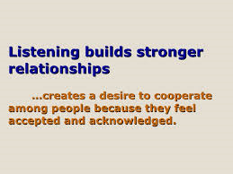
Listening Deeply to Understand
How might using the skills of Active Listening as an accommodation for cognitive or hearing impairments?

Slide 8
Active Listening as an Accommodation
Body Language
  As people lose other senses and abilities the capacity to read body language often increases.
Tone of Voice
  A person may not understand the words you are saying but they can often grasp emotion through tone of voice.
Paraphrasing
  Allows for validation and understanding of a person who is having a hard time expressing herself.
  Allows for others to hear the ideas of someone who speaks at a low volume.
Inquiry
  You can gage the level and complexity of your question to match a person’s cognitive abilities.

Slide 9

Engaging Others in Improvement
Strength and ability based accommodations and adaptations

Slide 10

Cognitive
Accommodations and Adaptations
What do you need?
What have you tried?
Suggestions:
  Active Listening
  Representative objects
  Small groups
  Flip charts

Slide 11
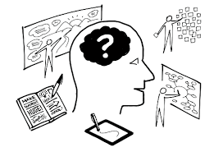
Visual
Accommodations and Adaptations
What do you need?
What have you tried?
Suggestions:
  White boards
  Written and distributed agendas (Large Print)
  Reading test for universal font size
  Flip charts
  Pass items around the group

Slide 12
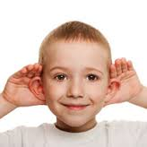
Auditory
Accommodations and Adaptations
What do you need?
What have you tried?
Suggestions:
  Use of microphones
  Use of pocket talkers
  A quiet location with no distractions
  Karaoke machines
  Seating arrangements

Slide 13
Physical/Mobility
Accommodations and Adaptations
What do you need?
What have you tried?
Suggestions:
  On unit/neighborhood meetings
  Small gatherings in a resident’s room
  Use larger spaces
  Wide doorways
  Card holders

Slide 14
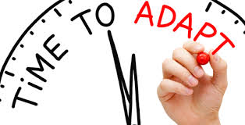
Group Design
Accommodations and Adaptations
What do you need?
What have you tried?
Suggestions:
  Use of committees
    Recreation Planning, Social, Welcome Wagon, Food Advisory, Fundraising, Charity and Community Outreach, Education, etc.
  Use of individual meetings
  Neighborhood meetings
  Parallel programs
  Variety of frequency and duration

Slide 15
Part I- Maximizing Engagement through Appreciation
Part II-Maximizing Engagement through
Accommodations and Adaptation
Kate Waldo, CTRS, ACC
National Director of Recreation and
Guest Services

Slide 16
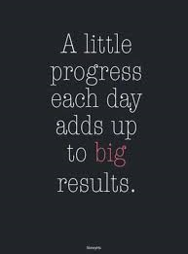
Commitments for Next Steps
What is the positive image you are moving towards?
Visualize the positive change.
Choose one or two things to implement starting today.
Include the Residents in the process and decision making; seek their input and involvement.
Do this “with” the Residents not “to” the Residents.

